Slide 1
PLACEMENT PATTERN EVALUATION
NAME : N.MADHUVANDHI
ROLL NO : 18LMCA09
GUIDE NAME : S. SARANYA M.C.A.,
3/01/2020
REGNO: 1738M7142

Slide 2
ABSTRACT
Placement pattern evaluation is used to evaluate the pattern for placement.
The project also evaluates the different questions involved in each pattern.
Based on the patterns and questions generated the mock test will be conducted for the students.
The report is finally generated based on the test attended.
3/01/2020
REGNO: 1738M7142

Slide 3
STUDY ON PROPOSED SYSTEM
The proposed system evaluates the pattern of different companies and the related questions.
Based on the patterns generated the mock test will be conducted for the students
Advantages:
Reduces the time for the students in searching the patterns in different websites.
Helps the students to effectively prepare for an interview.
3/01/2020
REGNO: 1738M7142

Slide 4
DEFINING THE PROBLEM
In the existing system, the placement company names and the details of the student will be available.
Student gathers the patterns and the questions by referring to different website.
Drawbacks:
The time taken for analyzing the patterns requires more time
Searching of questions for the related pattern is a tough process.
3/01/2020
REGNO: 1738M7142

Slide 5
DEVELOPING SOLUTION STRATEGIES
ADMINISTRATOR MODULE
    Admin Login or Faculty Login
    Company Pattern Setup
    Company Question Setup
    Mock Test Setup
    Student Report
STUDENT MODULE
      Student Login
      Mock Test
      Report
3/01/2020
REGNO: 1738M7142

Slide 6
SYSTEM SPECIFICATION
Front End
JAVA
Back End
MySQL
3/01/2020
REGNO: 1738M7142

Slide 7
HARDWARE SPECIFICATION
CPU : Intel i5 CORE
RAM : Minimum of 4GB RAM
Hard Disk : 10GB or More
Monitor : 15”CRT or LCD monitor
Keyboard : Normal or Multimedia
3/01/2020
REGNO: 1738M7142

Slide 8
SOFTWARE SPECIFICATION
Operating System : Windows 8 / 7
Front End : Java
Framework : Spring Boot with MVC
Tool : Eclipse IDE
Database : MySQL
3/01/2020
REGNO: 1738M7142

Slide 9
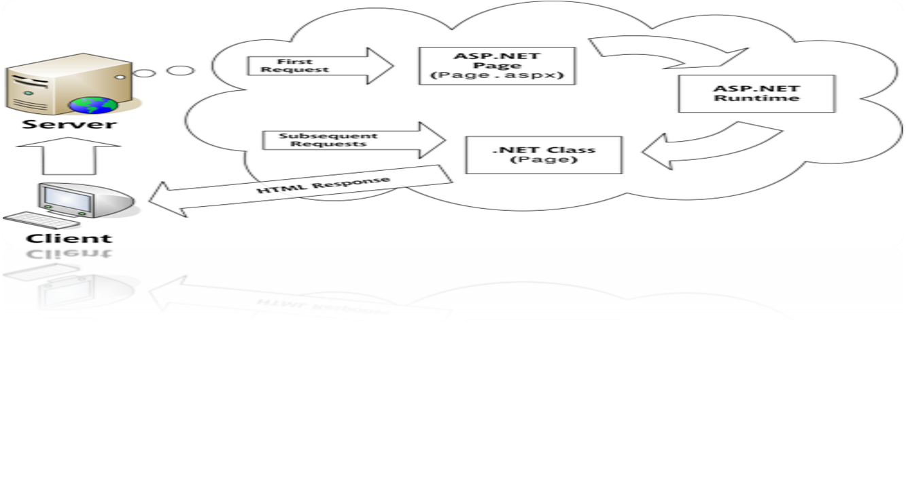
APPLICATION SPECIFICATION
Client/server architecture is a producer/consumer computing architecture where the server acts as the producer and the client as a consumer.
The server provides high-end, computing-intensive services to the client on demand.
3/01/2020
REGNO: 1738M7142

Slide 10
COST ESTIMATION AND SCHEDULING
COCOMO COST ESTIMATION TECHNIQUE
No of days worked = 74 days
1 day work = 8 Hours
Total no of hours = 592 Hours
Cost for 1 hour = ₹ 100
Total number of cost =Total number of hours*cost for 1 hour Cost = 592*100 = 59,200/-
Therefore total cost of the product is ₹ 59,200/-
3/01/2020
REGNO: 1738M7142

Slide 11
FINAL OUTLINE OF THE PROPOSED SYSTEM
The system provides a user friendly interface. The students can view the pattern and questions of various companies easily.
The test helps the student to effectively prepare for the interview.
This reduces the time involved in searching.
3/01/2020
REGNO: 1738M7142

